Slide 1
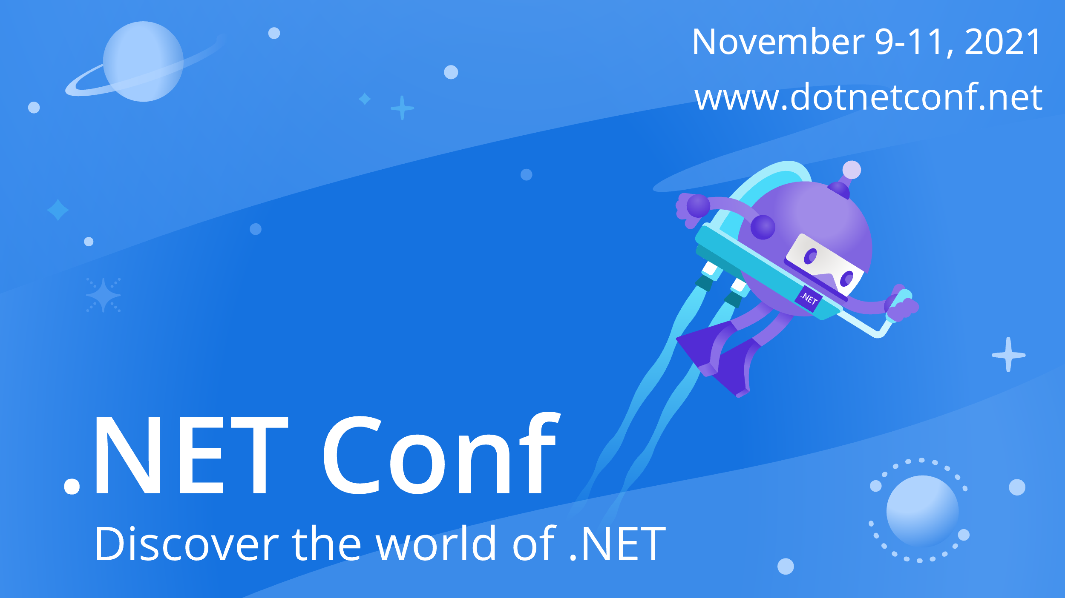

Slide 2



Building microservices with Dapr and .NET
Paul Yuknewicz
Product Lead, Azure Dev Platform & Frameworks
@paulyuki99

Slide 3
What is holding back microservice development?
Limited tools and runtimes to build distributed applications
Runtimes have limited language support and tightly controlled feature sets
Runtimes only target specific infrastructure platforms with limited portability

Slide 4
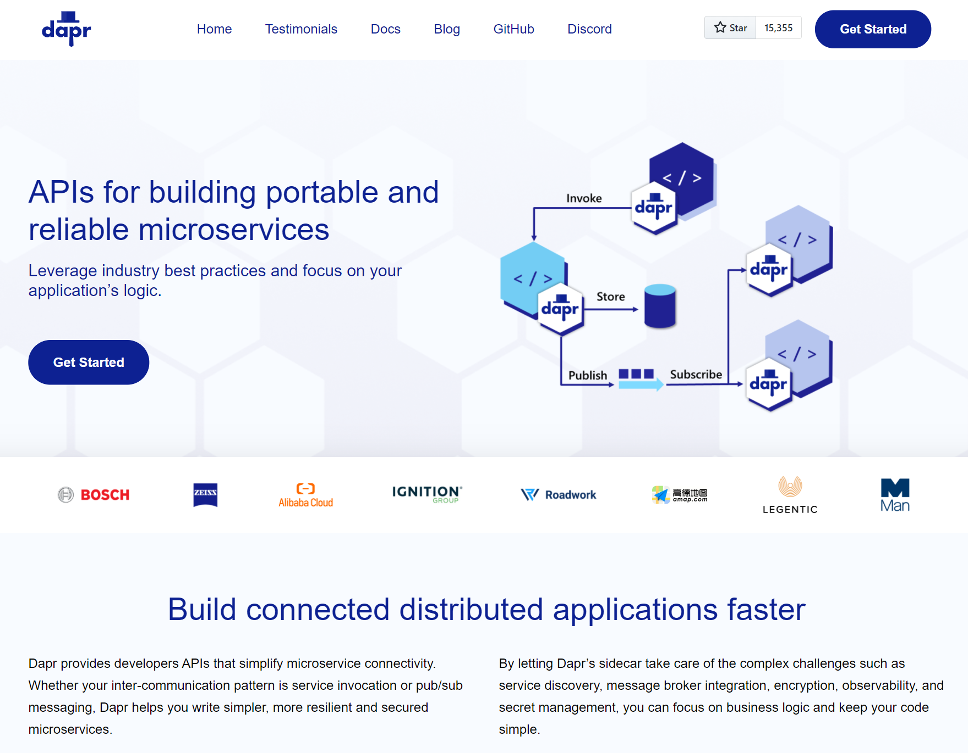

Distributed Application Runtime
dapr.io

Slide 5
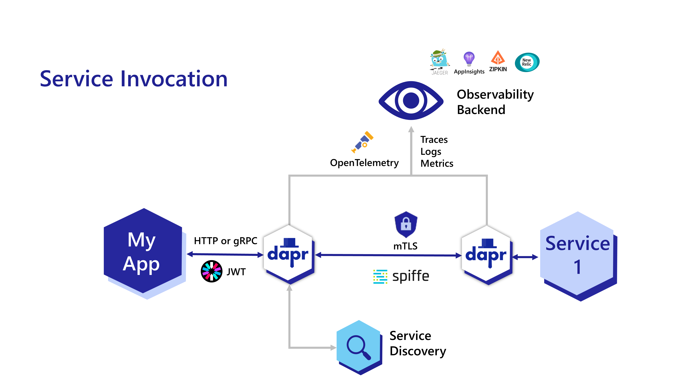
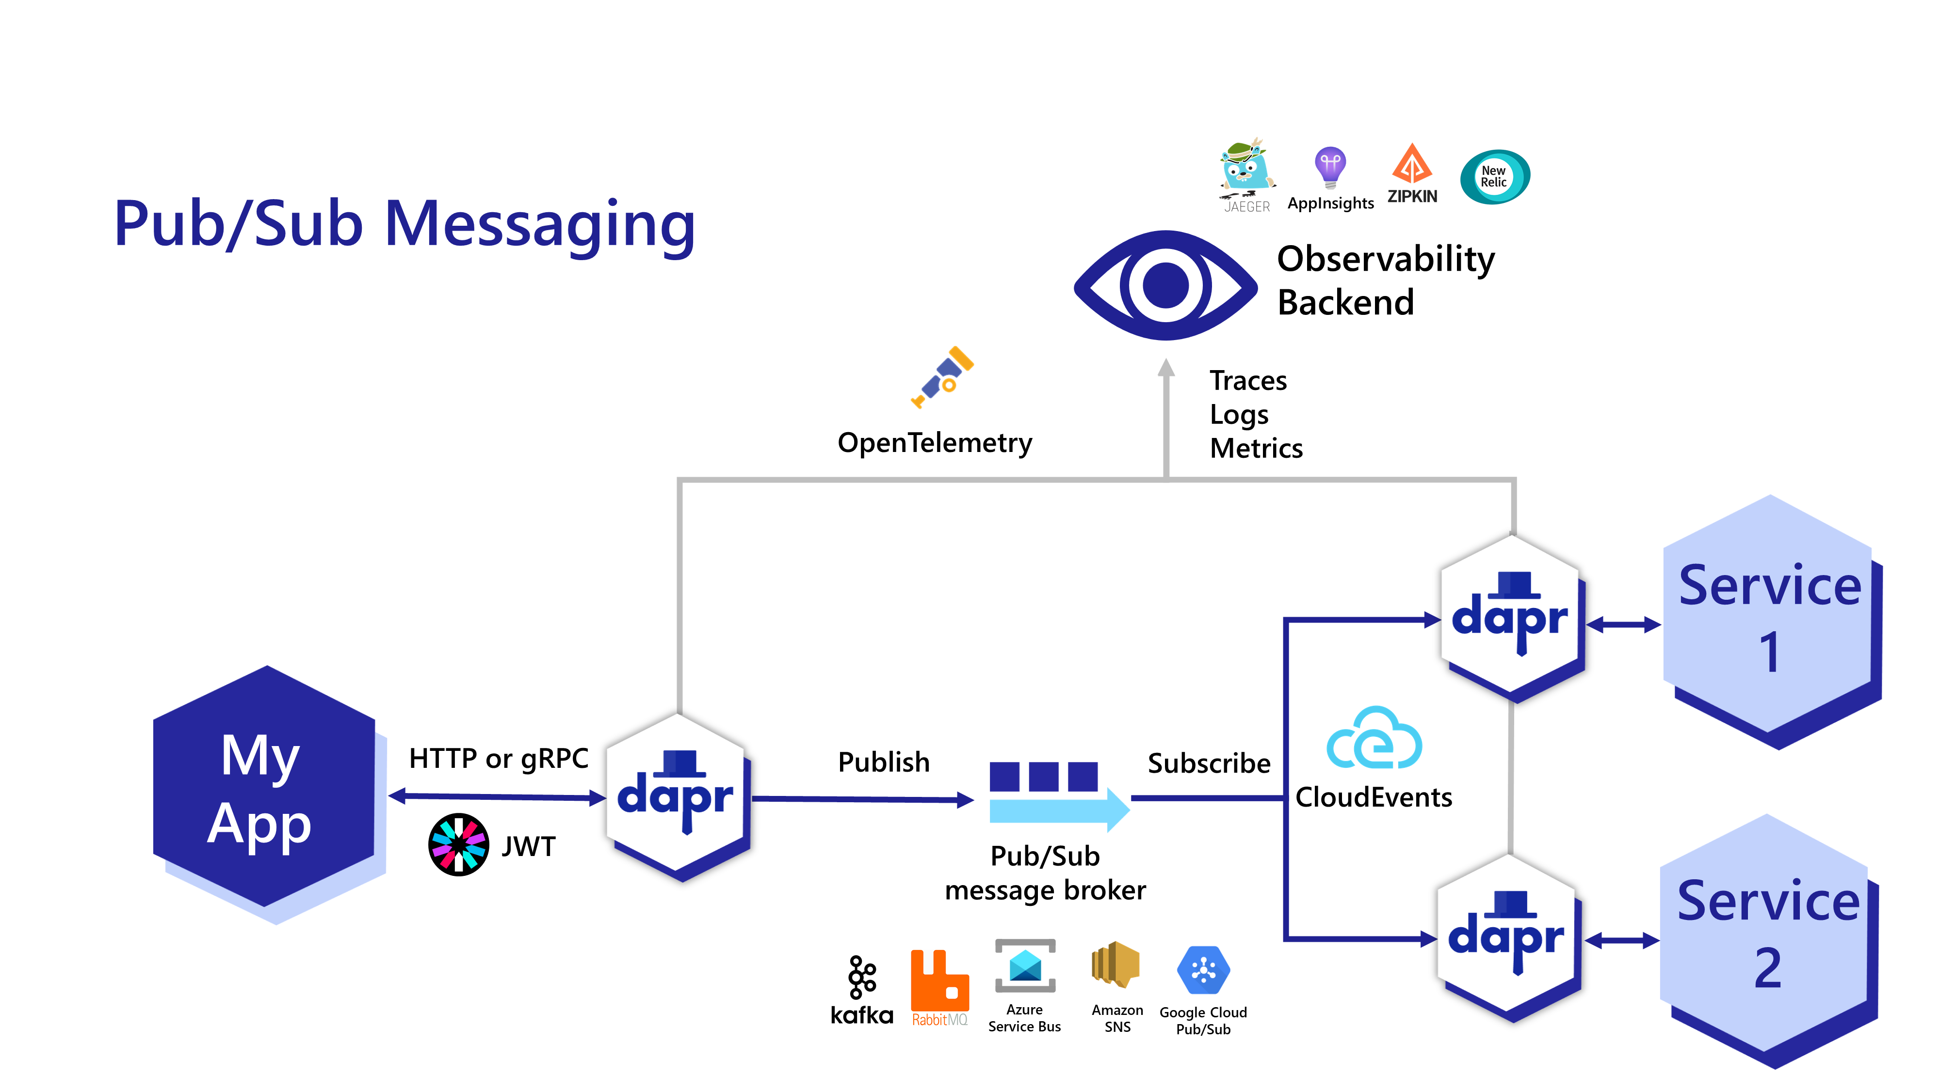
Build connected distributed applications faster
APIs for building microservices easily
Resiliency built-in
Message and event broker integrations
Service discovery
mTLS encryption
Secrets
..thanks to sidecar process

Slide 6
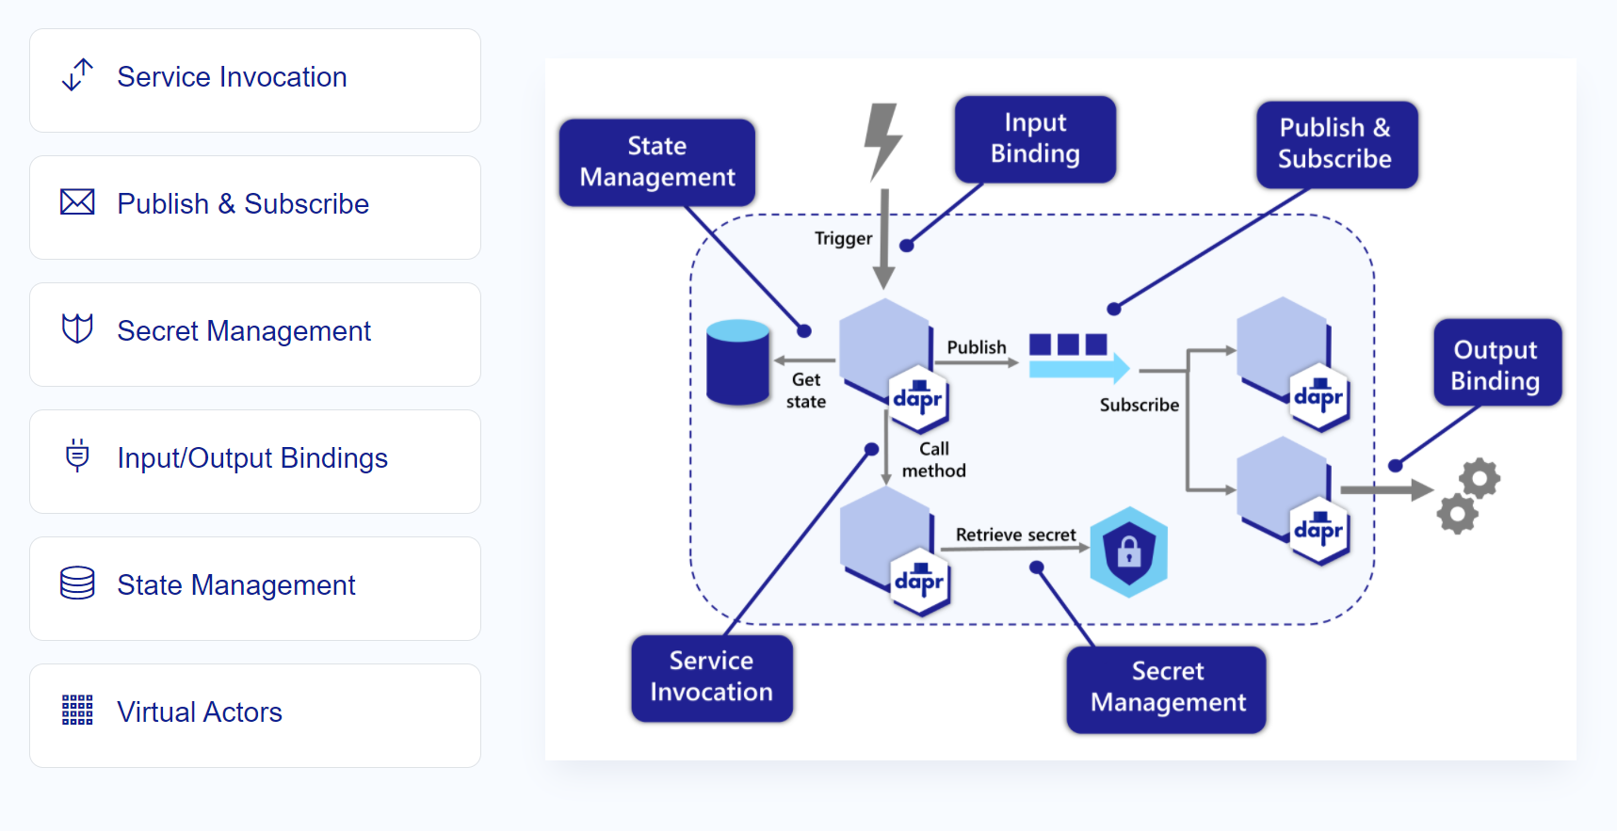
APIs for solving microservices challenges

Slide 7

Sidecar model
Application
Dapr sidecar
My App
Dapr API
HTTP/gRPC
POST http://localhost:3500/v1.0/invoke/cart/method/neworder
GET http://localhost:3500/v1.0/state/inventory/item67
POST http://localhost:3500/v1.0/publish/shipping/orders
GET http://localhost:3500/v1.0/secrets/keyvault/password

Slide 8

Incrementally adoptable
Only the APIs you want
With any stack or language
Reuse your code with HTTP/gRPC proxy
Kubernetes, VMs, cloud or hybrid
var request = new HttpRequestMessage();
request.RequestUri = new Uri(BASE_URL); //”http://localhost:3500”
request.Headers.Add(“dapr-app-id”, configuration[“SCORE_SERVICE"]);
request.Method = HttpMethod.Post;
request.Content = new StringContent(requestBody, Encoding.UTF8, "application/json");
request.Headers.Add("X-ClientTraceId", Guid.NewGuid().ToString());
return request;

Slide 9
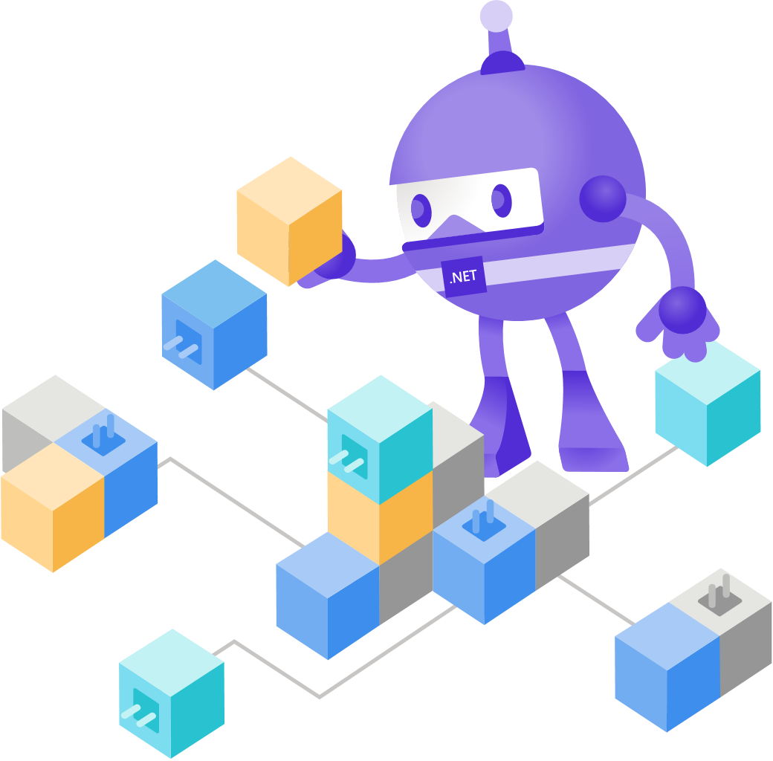
Demo
APIs for microservice communication

Slide 10
Industry established best practices for reliability
Secured connections (mTLS)
Resilient state
Retries, backoffs, circuit breakers
Message guarantees
Observability

Slide 11
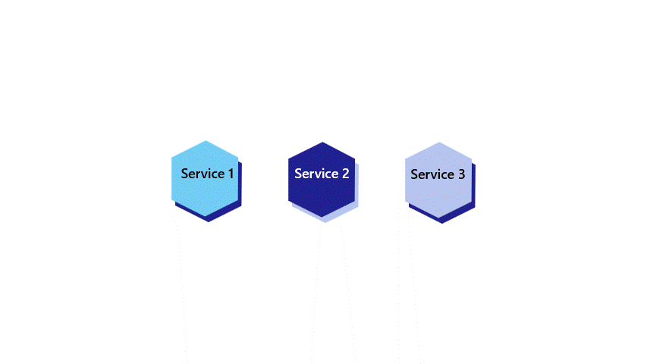
Build portable applications
Write portable code once, and reconfigure for any environment:
Local, staging, prod
Multi-cloud
On-prem and edge
Favorite cloud or OSS storage, pub-sub brokers, secrets stores

Slide 12

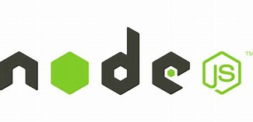



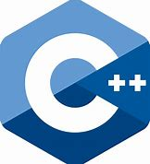

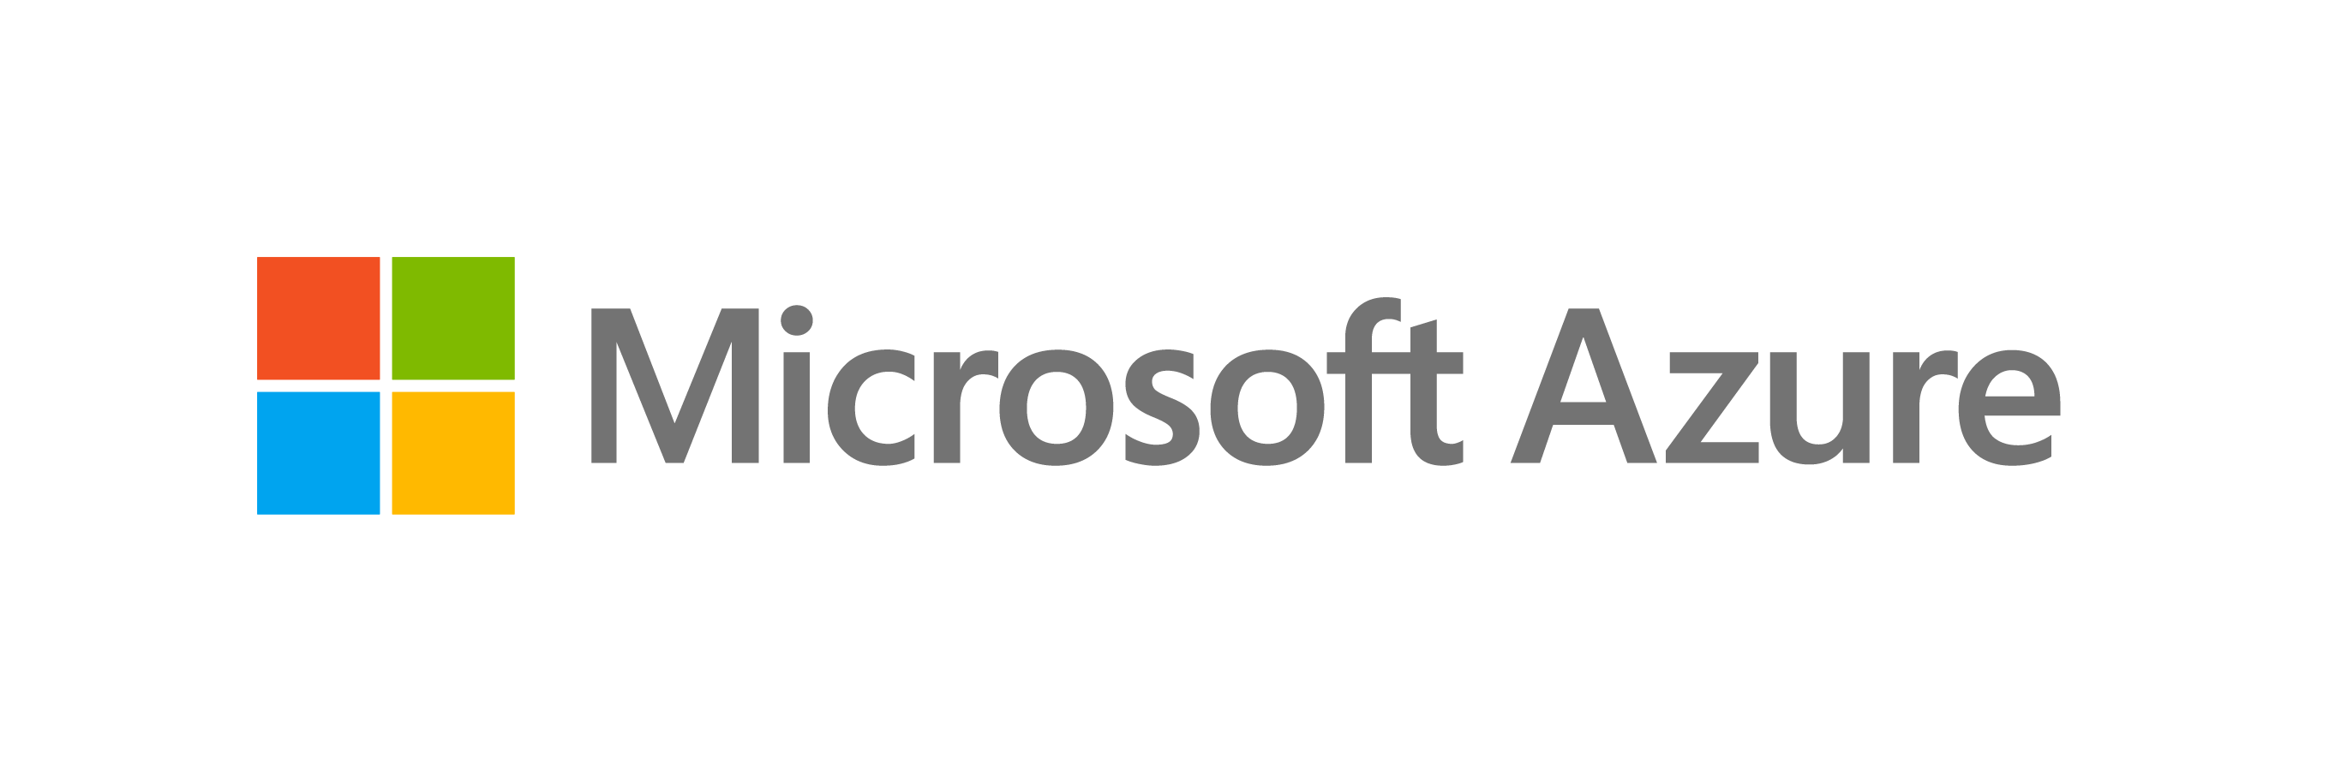



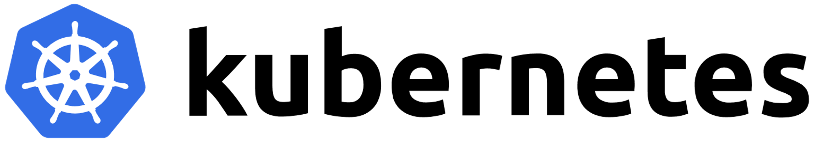


Any cloud or edge infrastructure
Application code
Microservices written in
Any code or framework…
HTTP API
gRPC API
Service-to-service invocation
State management
Publish and subscribe
Resource bindings and triggers
Actors
Observability
Secrets
Extensible
Hosting infrastructure
Azure Arc
On-Premises

Slide 13








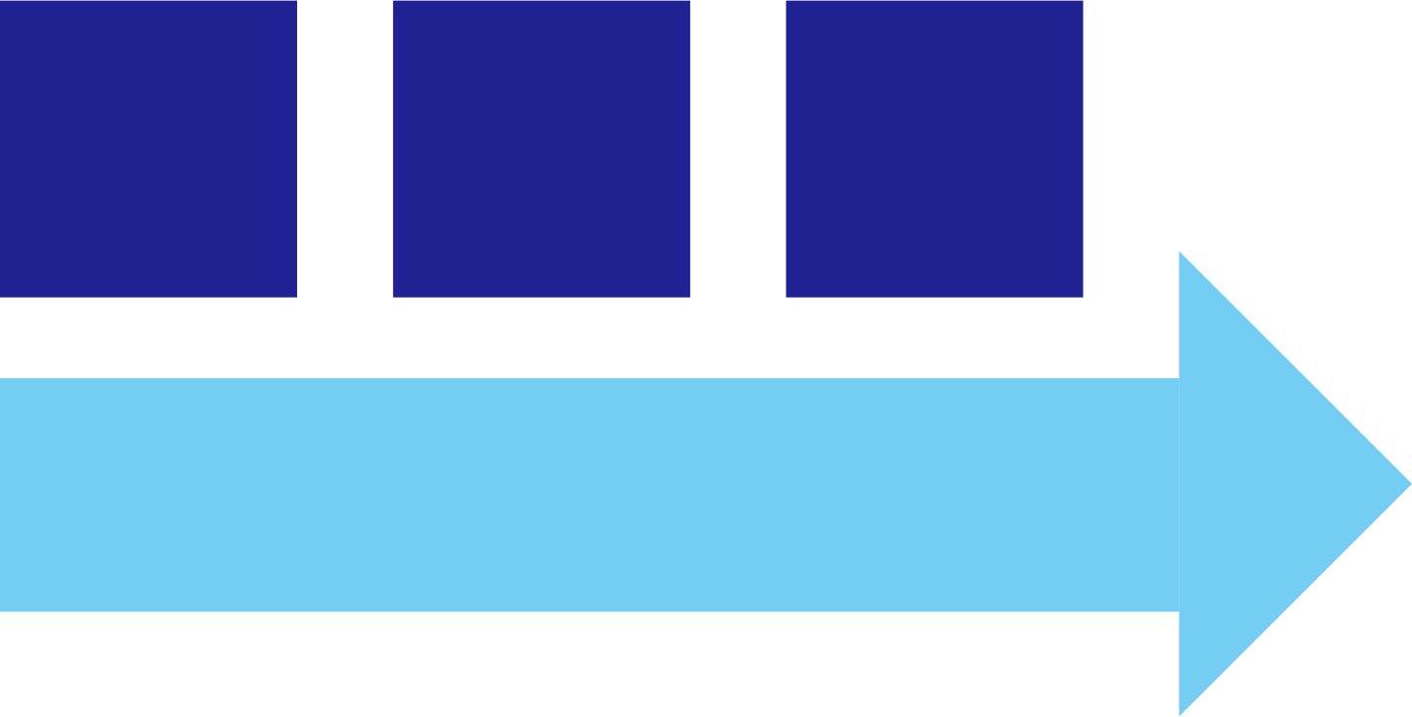




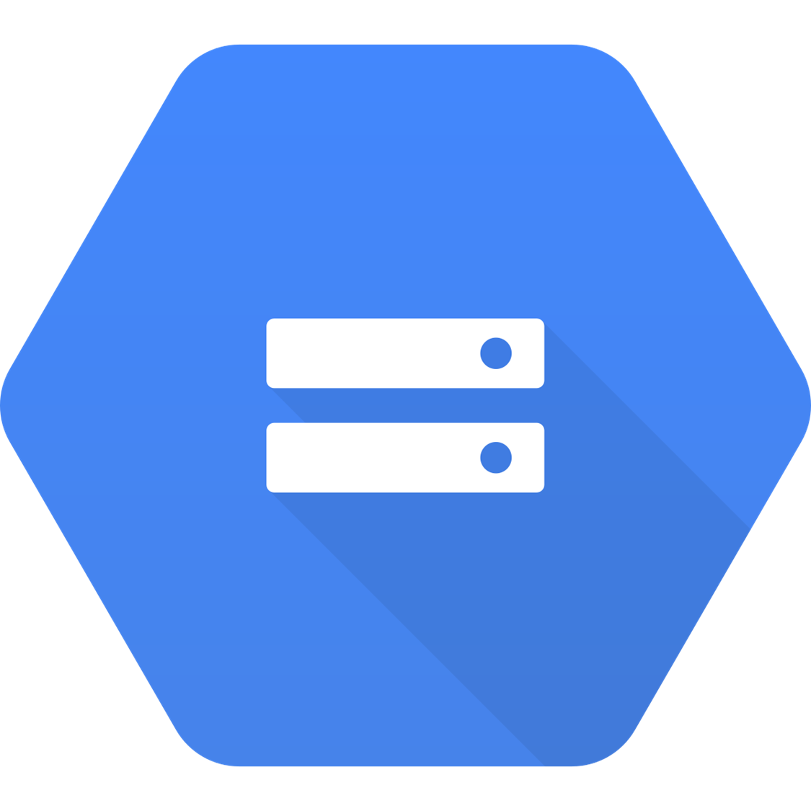







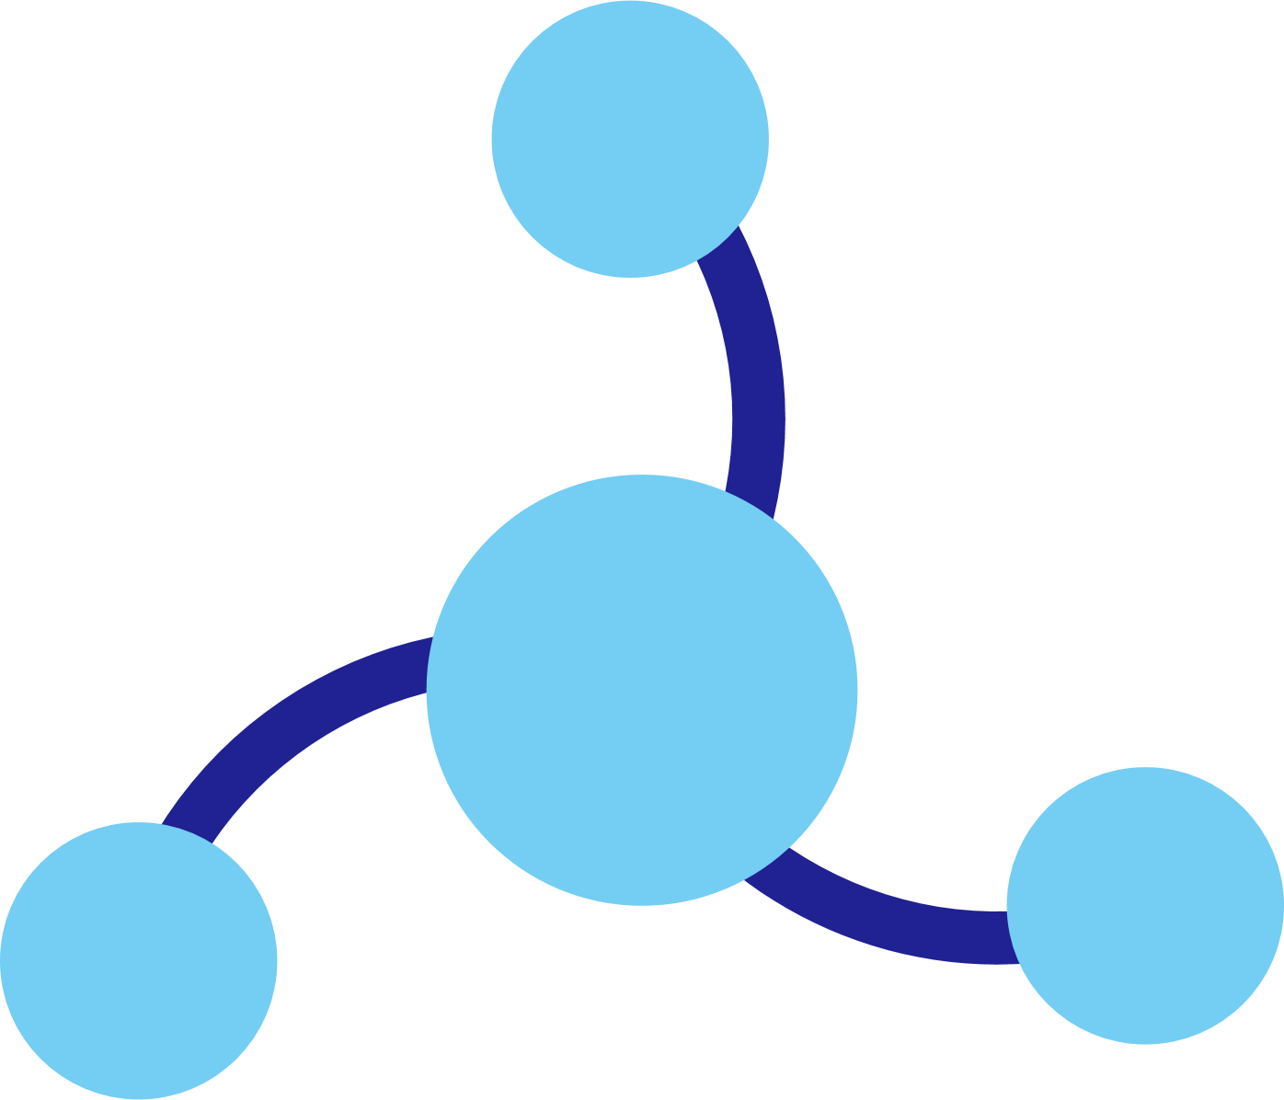




Dapr components
State
Stores
AWS
DynamoDB
Azure
CosmosDB
Firebase
Redis
Cassandra
PubSub
Brokers
AWS
SQS
Azure
Service Bus
GCP
Pub/Sub
Redis
RabbitMQ
My App
Bindings
& Triggers
AWS
S3
Azure
Storage
GCP
Storage
Twilio
Kafka
Swappable YAML files with
resource connection details
Over 70 components available
Create components for your resource at: github.com/dapr/components-contrib
Secret
Stores
AWS
Secrets Manager
Azure
KeyVault
GCP
Secret Manager
HashiCorp
Vault
Kubernetes
Secret
Observability
Prometheus
AppInsights
Zipkin
Jaeger

Slide 14
Demo
Portable apps

Slide 15

Next steps
Getting Started guide: https://docs.dapr.io/getting-started/
Dapr SDK for .NET: https://docs.dapr.io/developing-applications/sdks/dotnet/
Azure Container Apps: https://aka.ms/containerapps
Azure Kubernetes Service (AKS): https://aka.ms/dapraks
Sample – Store API: https://aka.ms/daprstoreapi
Sample – Twitter sentiment: https://aka.ms/daprtwitter
Join the community: https://github.com/dapr/community/blob/master/README.md

Slide 16
Code Sample
Code sample

Slide 17
Announcemnet
Value prop 1
Value prop 2
Value prop 3

Slide 18
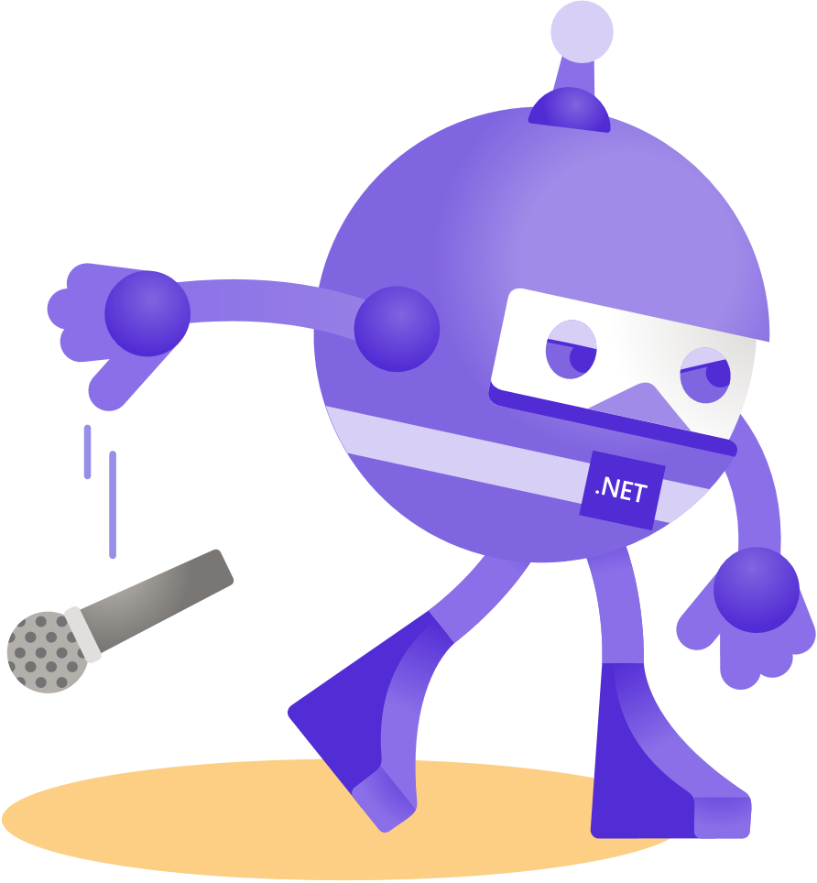
Thanks for joining!

Slide 19


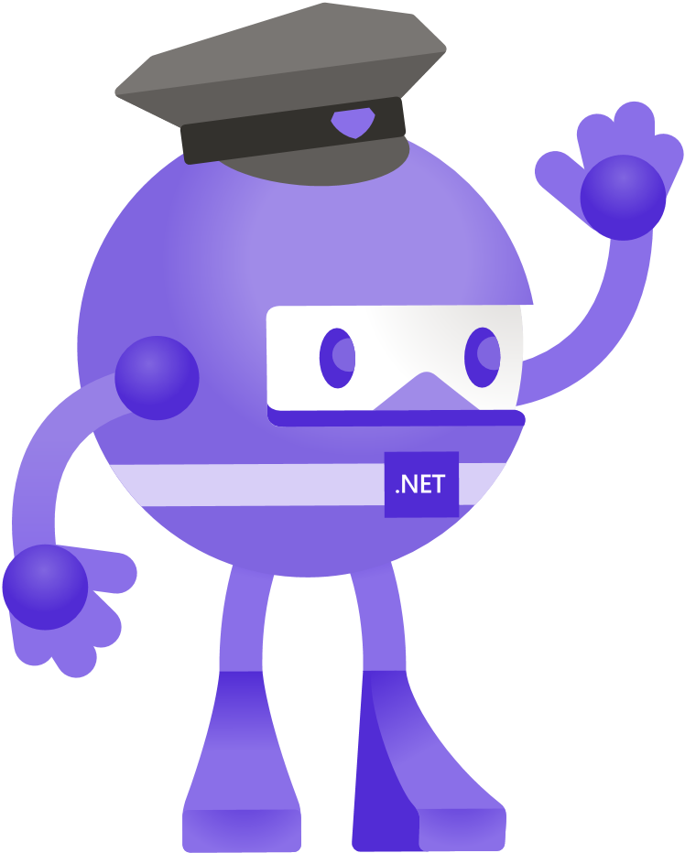



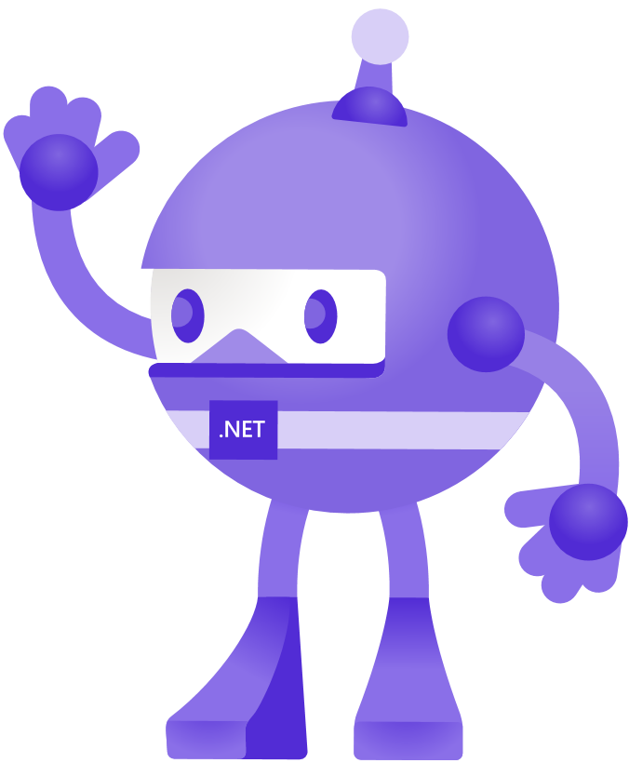


Slide 20
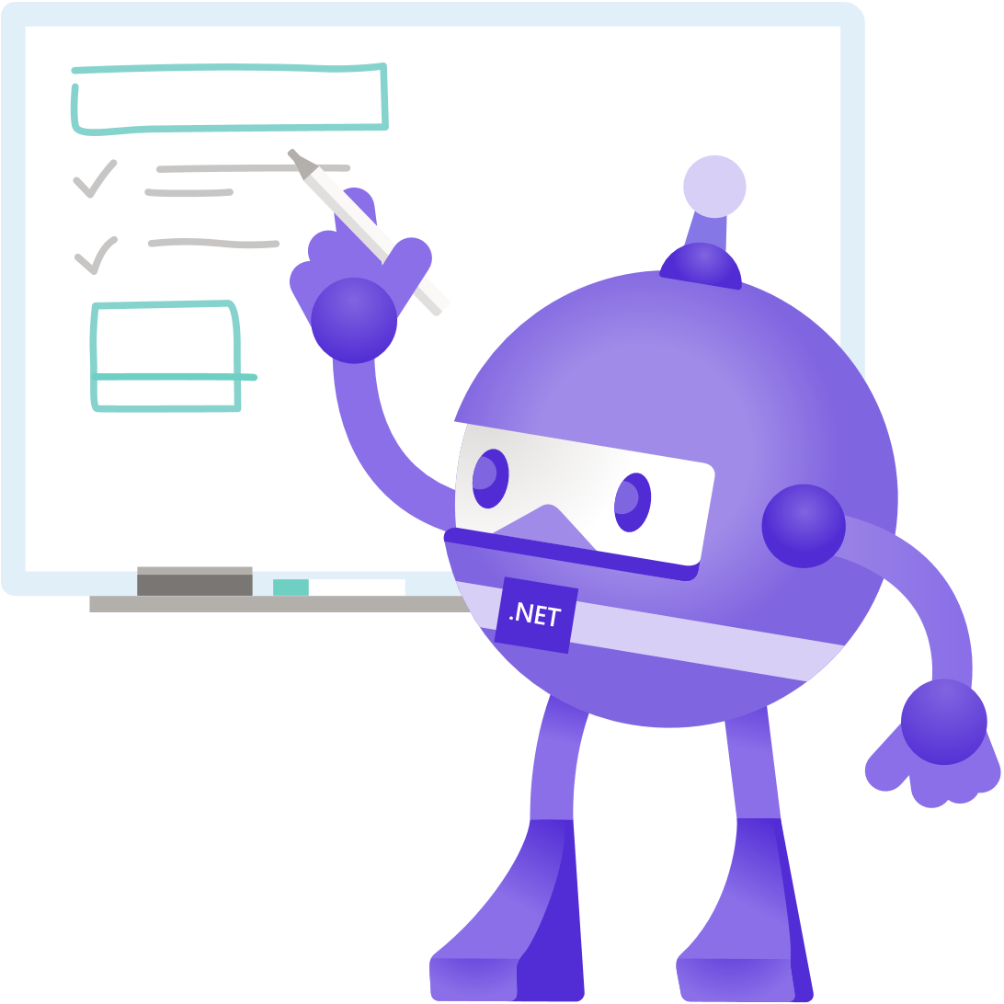



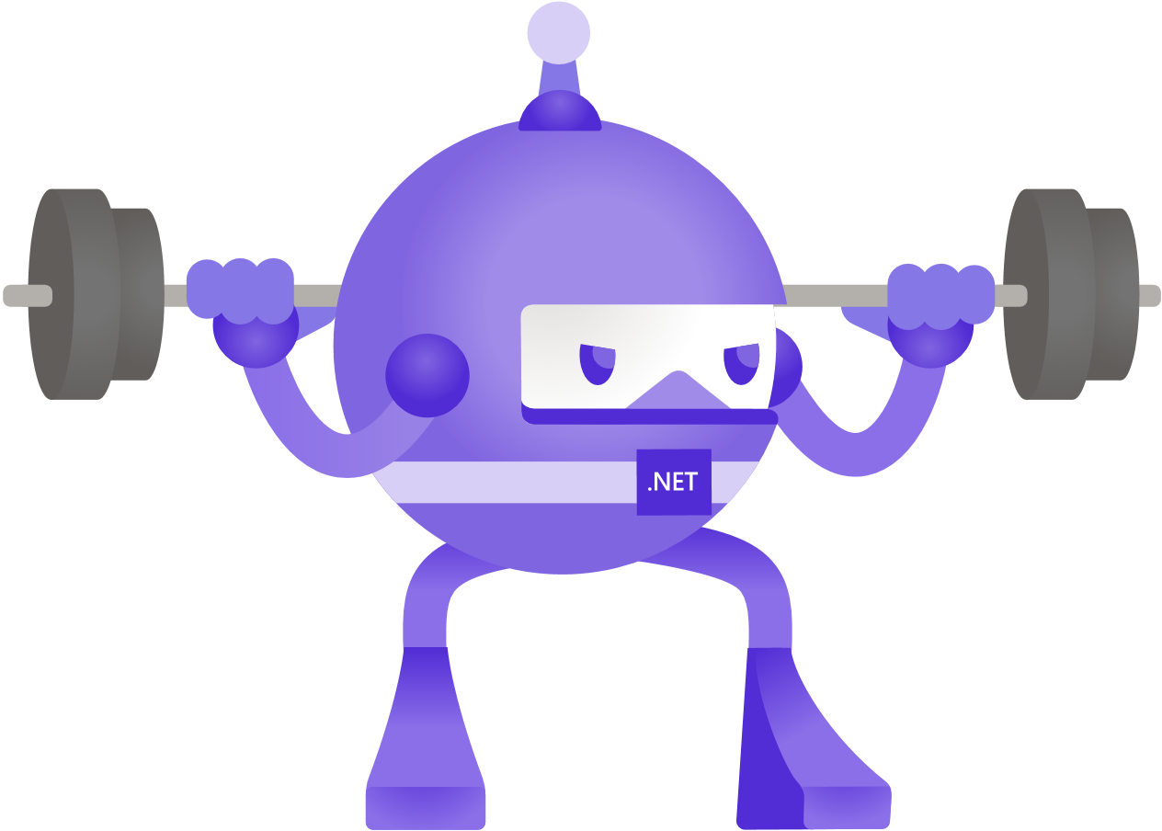
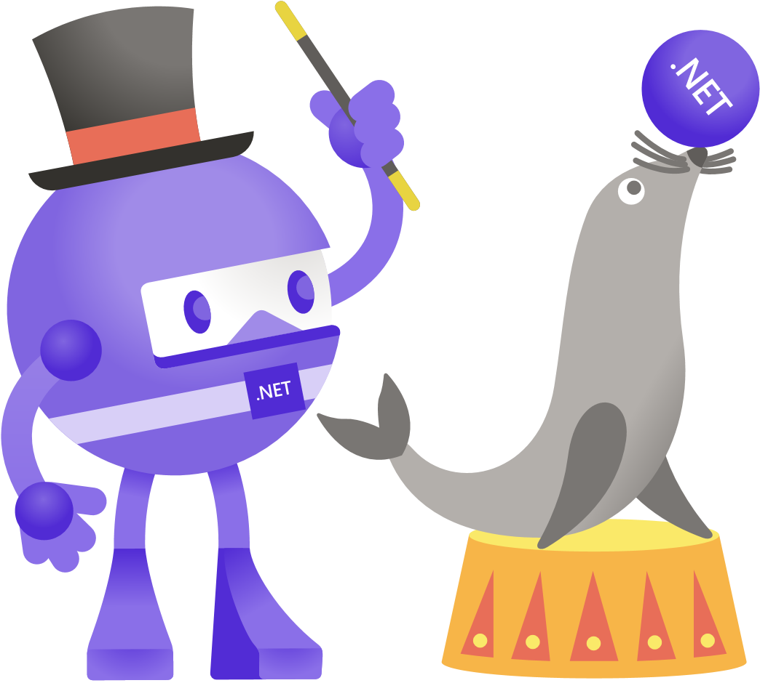
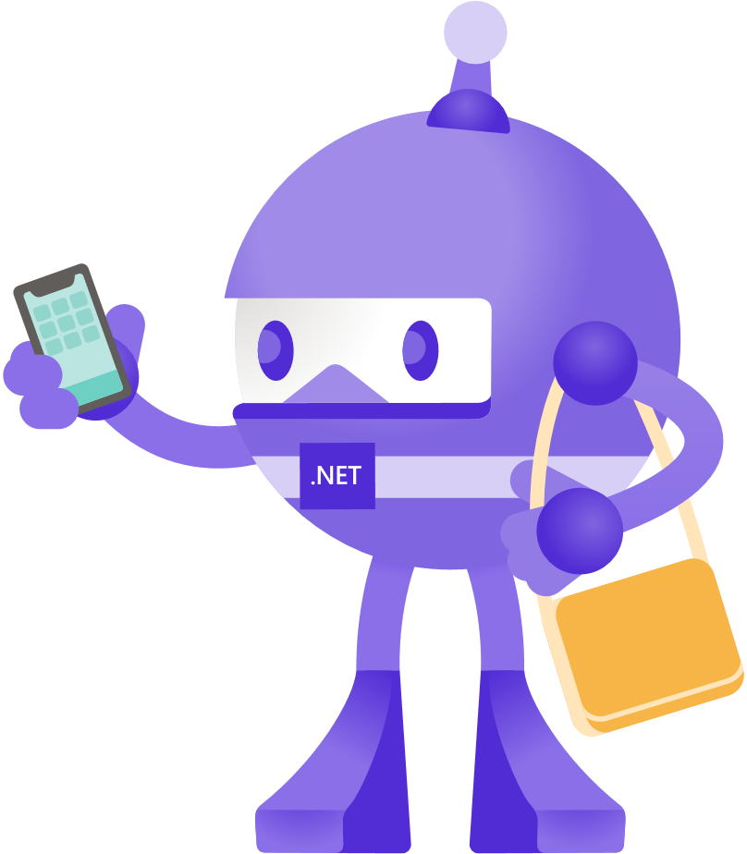

Slide 21


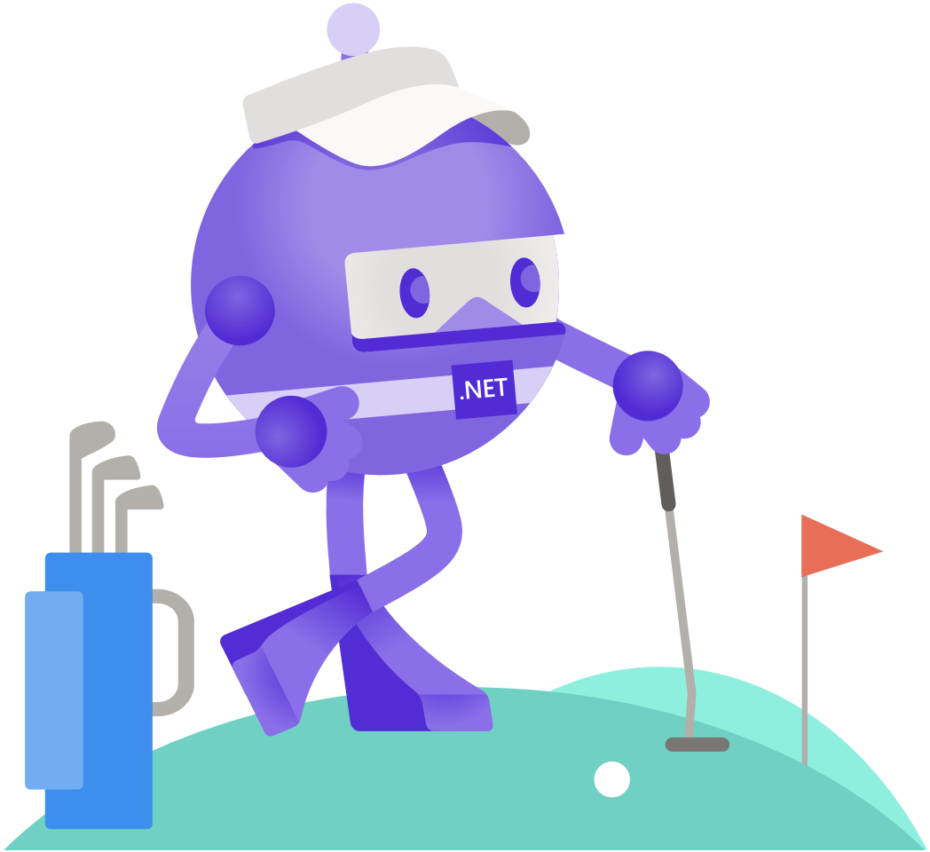
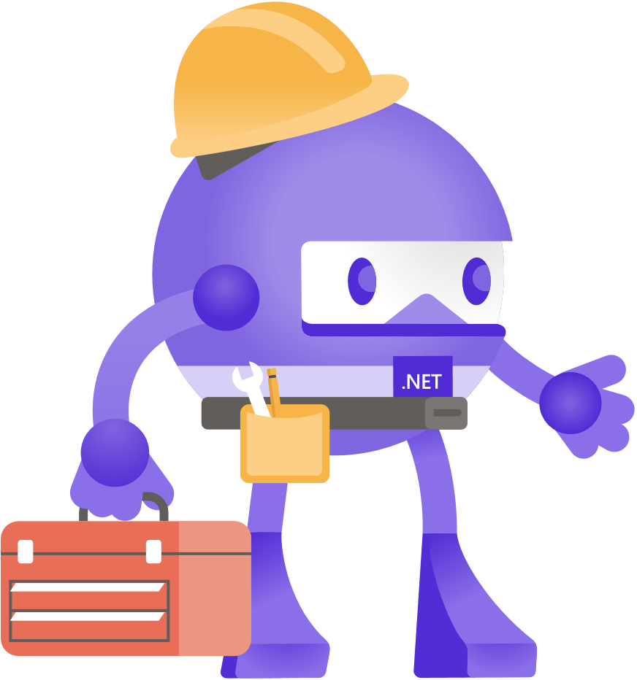

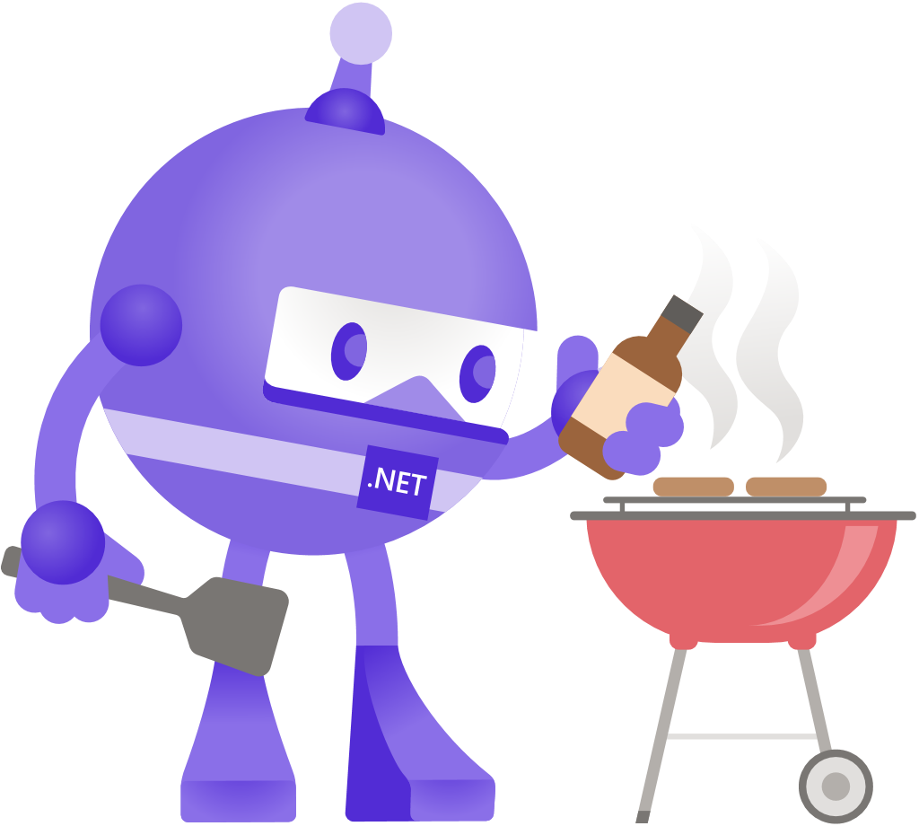

Slide 22


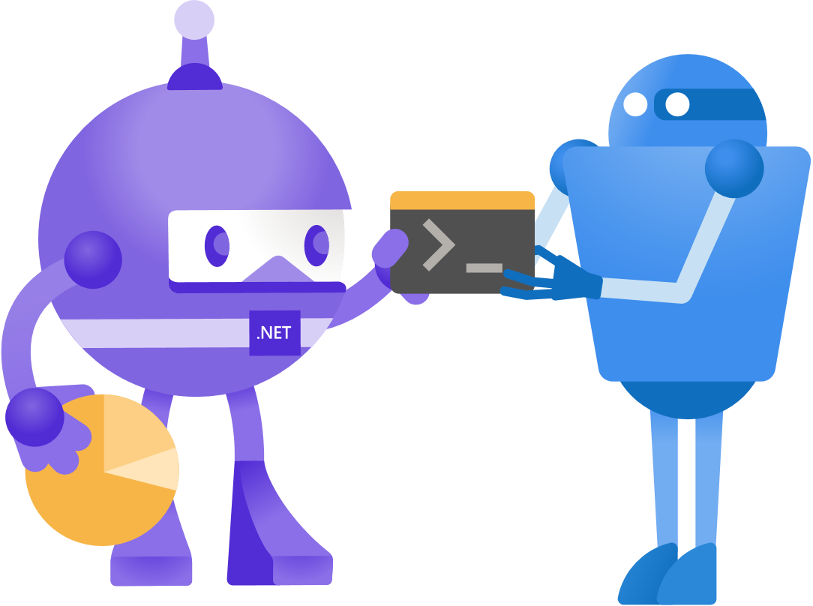
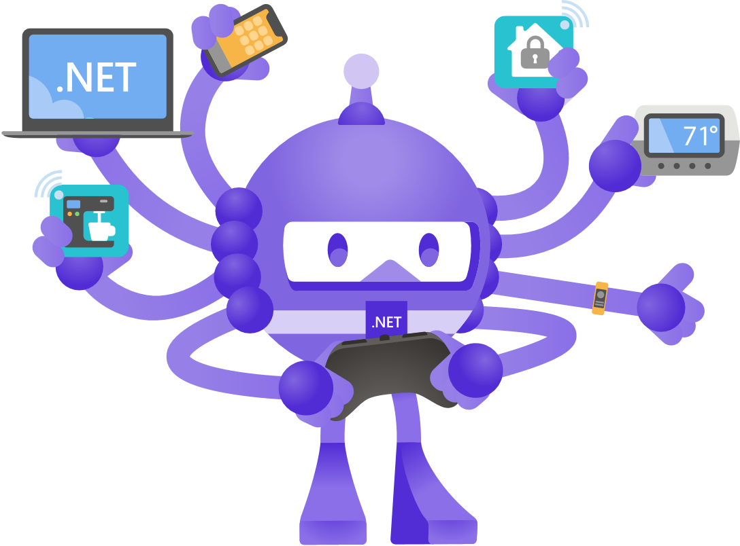
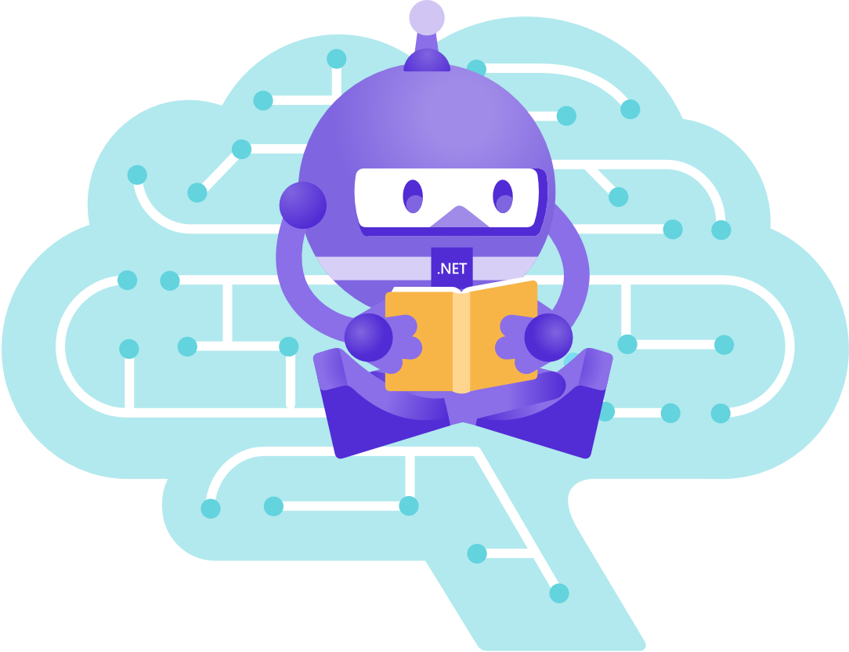
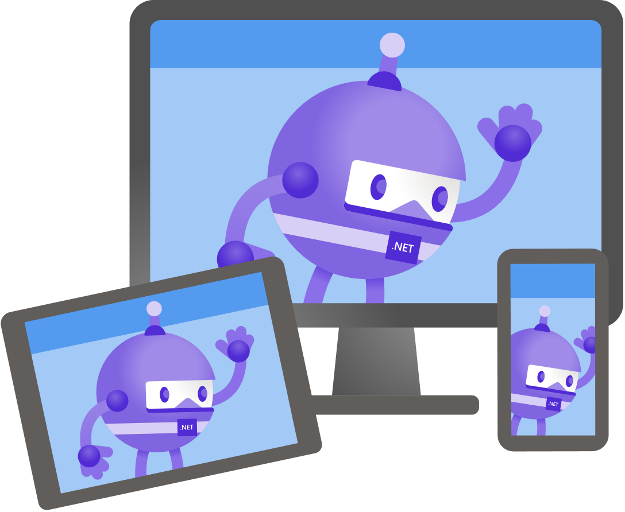

Slide 23
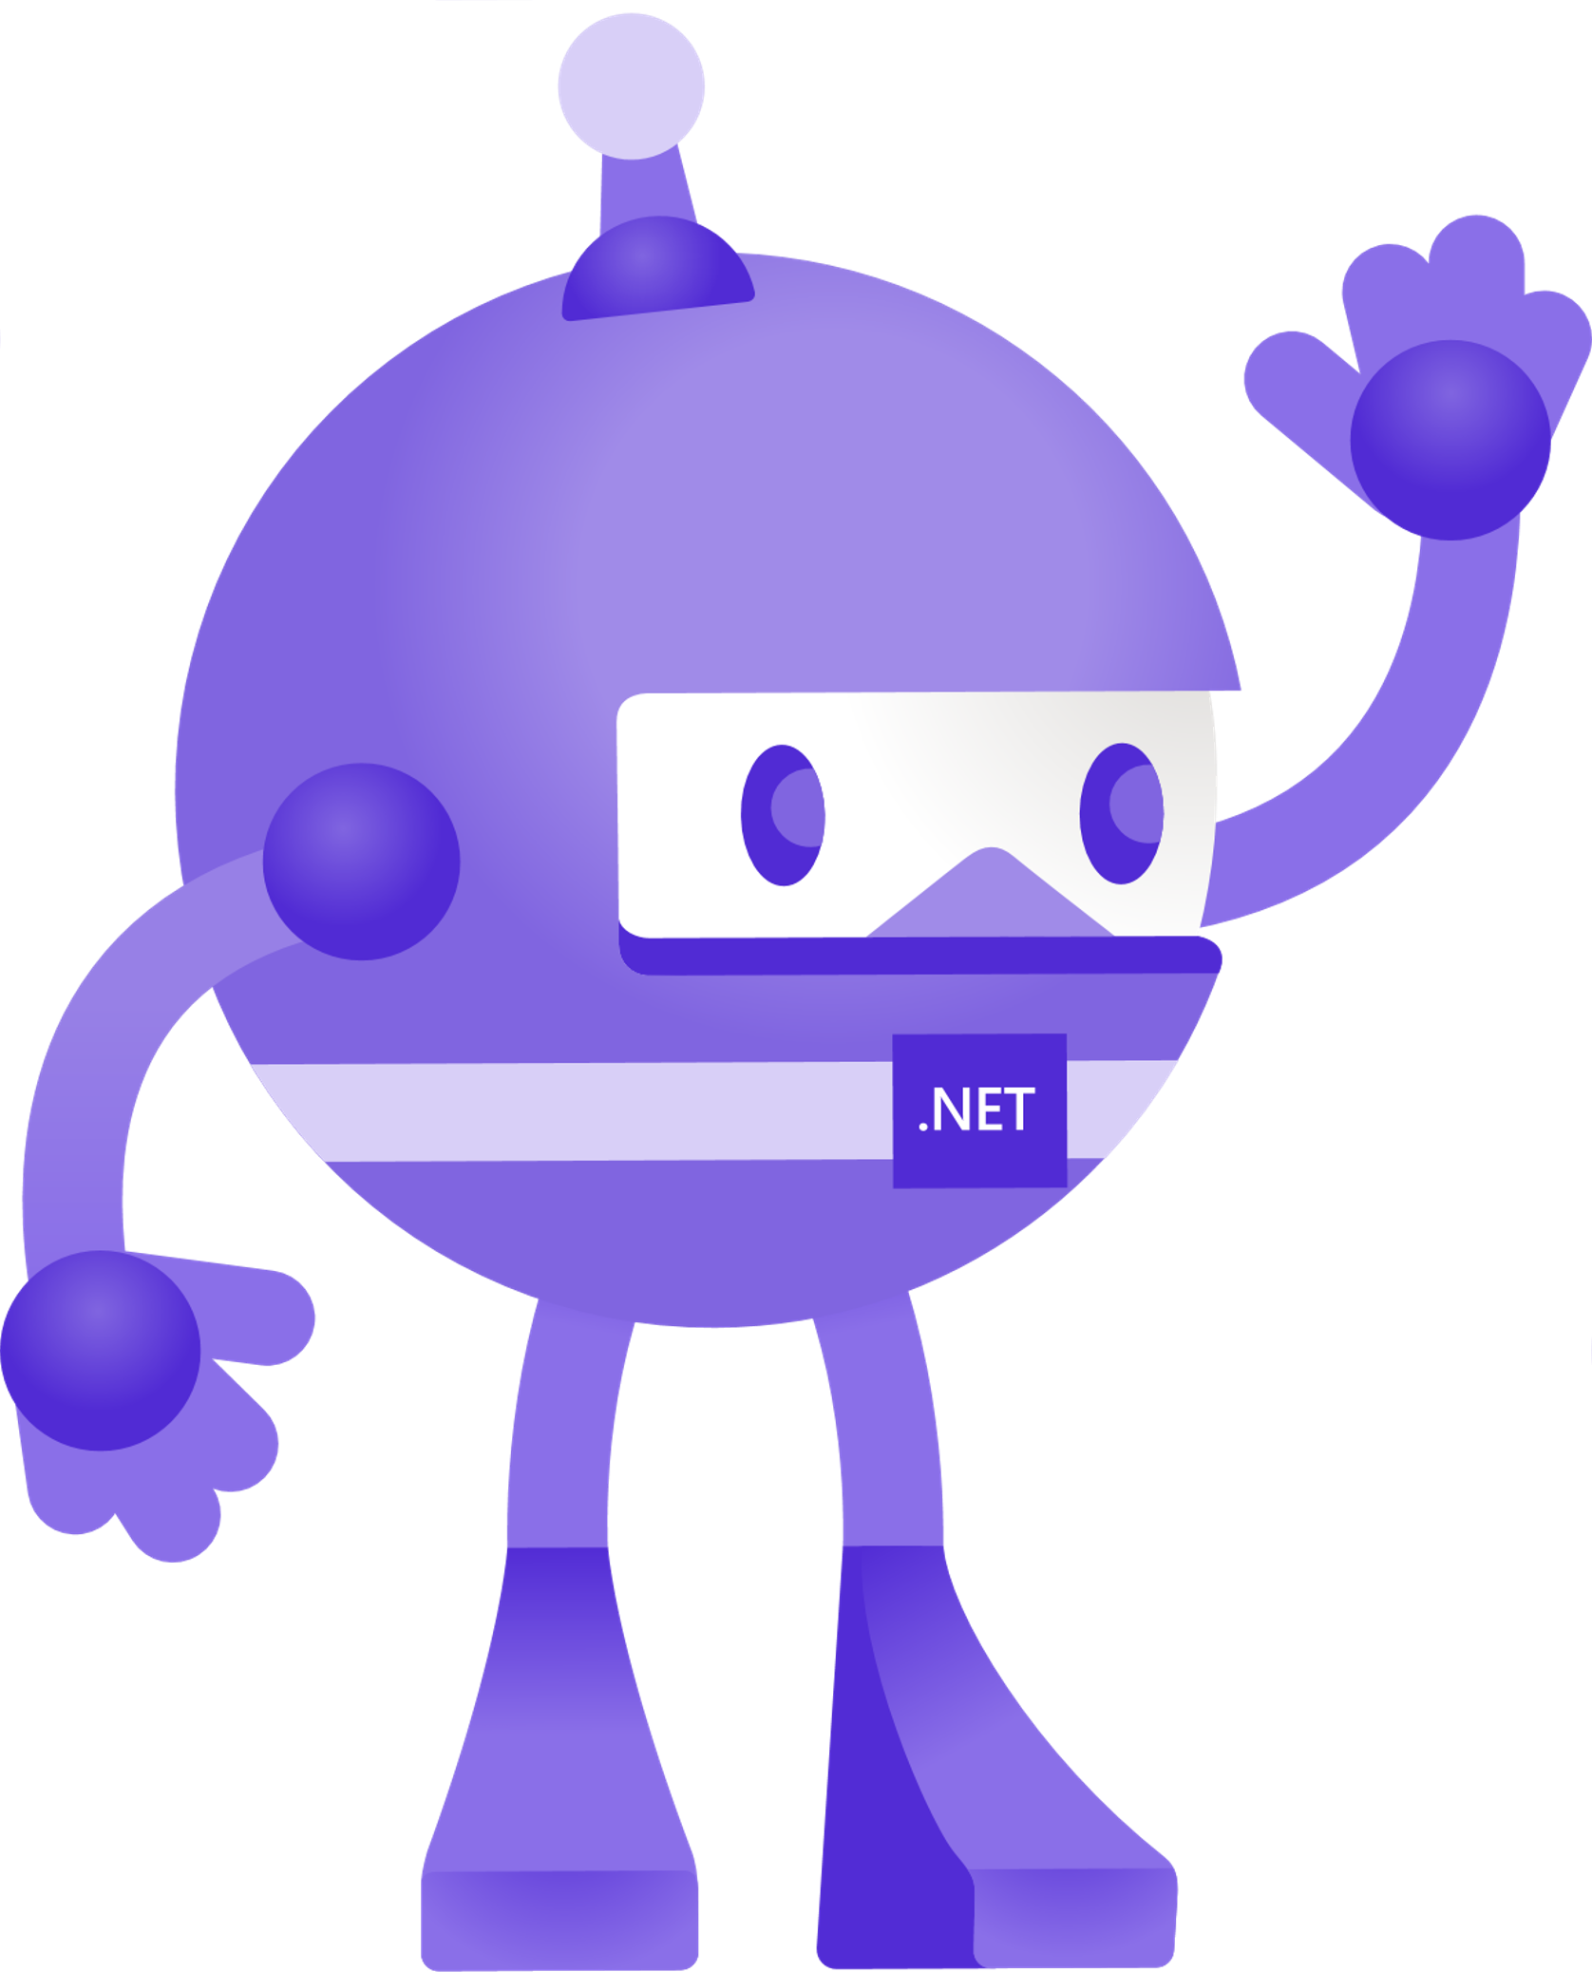




Slide 24


Slide 25


Slide 26


Slide 27


Slide 28


